Slide 1
Backtracking algorithms
Name : Khaled ahmed Zakaria
Reg. number : 17101227

Slide 2
What is backtracking algorithms?
Backtracking is a general algorithm for finding solutions to some computational problems, notably constraint satisfaction problems, that incrementally builds candidates to the solutions, and abandons a candidate ("backtracks") as soon as it determines that the candidate cannot possibly be completed to a valid solution.

Slide 3
Backtracking depends on user-given "black box procedures" that define the problem to be solved, the nature of the partial candidates, and how they are extended into complete candidates. It is therefore a metaheuristic rather than a specific algorithm – although, unlike many other meta-heuristics, it is guaranteed to find all solutions to a finite problem in a bounded amount of time.

Slide 4
Uses of backtracking:
Backtracking is an important tool for solving constraint satisfaction problems, such as crosswords, verbal arithmetic, Sudoku, and many other puzzles. It is often the most convenient technique for parsing, for the knapsack problem and other combinatorial optimization problems. It is also the basis of the so-called logic programming languages such as Icon, Planner and Prolog.

Slide 5
Sudoku
Sudoku is originally called Number Place which is a logic based, combinatorial number-placement puzzle. The objective is to fill a 9×9 grid with digits so that each column, each row, and each of the nine 3×3 subgrids that compose the grid (also called "boxes", "blocks", or "regions") contain all of the digits from 1 to 9. The puzzle setter provides a partially completed grid, which for a well-posed puzzle has a single solution.

Slide 6
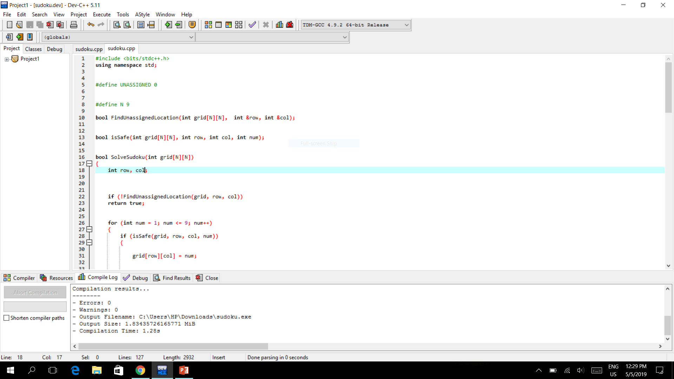
sudoku

Slide 7
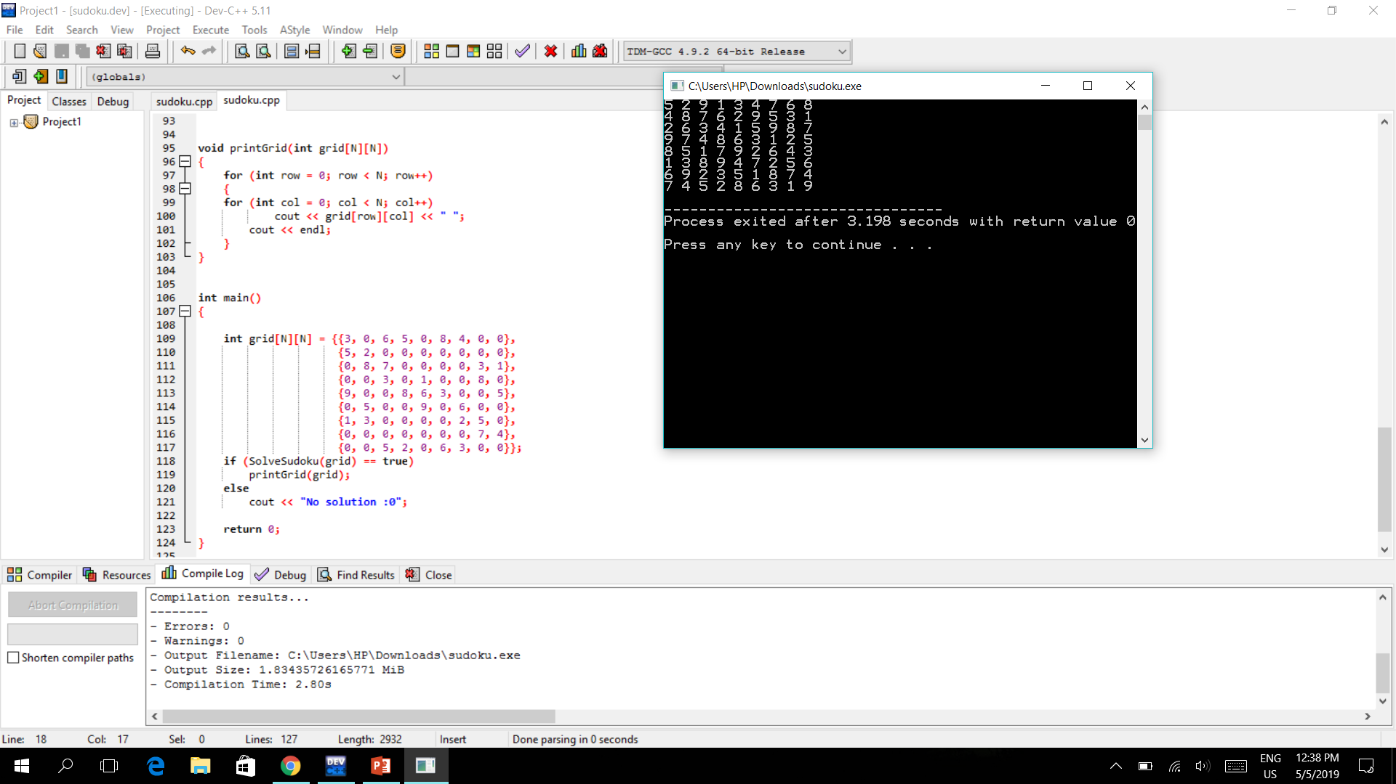

Slide 8
Thank You

